Slide 1
Selenium WebDriver

Slide 2
Automation Testing
specialized tools to automate the execution of manually designed test cases without any human intervention
access the test data, controls the execution of tests and compares the actual result against the expected result, generating detailed test reports of the system under test

Slide 3
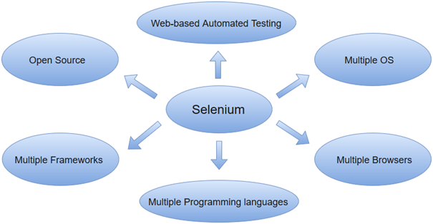
Selenium WebDriver

Slide 4
OS support: Android, iOS, Windows, Linux, Mac, Solaris
Browsers support: Google Chrome, Mozilla Firefox, Internet Explorer, Edge, Opera, Safari
Languages support: C#, Java, Python, PHP, Ruby, Perl, JavaScript
Frameworks Supported: TestNG, Junit, Ant, Maven

Slide 5
Selenium WebDriver Installation
Download and Install Java 8 or higher version.
Download and configure Eclipse or any Java IDE of your choice.
Download Selenium WebDriver Java Client
Configure Selenium WebDriver

Slide 6
Selenium setup for Chrome Browser
System.setProperty("webdriver.chrome.driver",
“Path of the web driver");
WebDriver driver=new ChromeDriver();
driver.get(“URL of website under test");
driver.manage().window().maximize();

Slide 7
Selenium setup for Firefox Browser
System.setProperty("webdriver.gecko.driver",
“Path of the web driver");
WebDriver driver=new FirefoxDriver();
driver. get(“URL of website under test");
driver. manage().window().maximize();

Slide 8
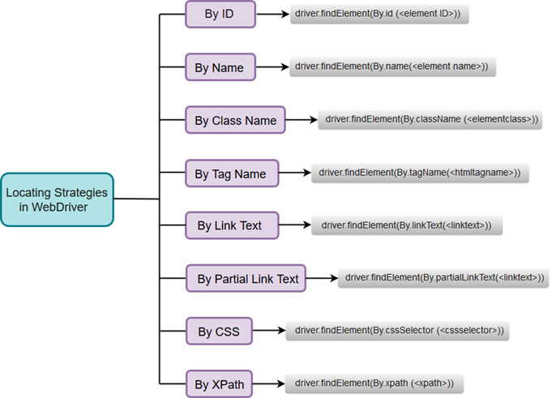
Locators in Selenium

Slide 9
FindElement and FindElements in Selenium WebDriver
FindElement command syntax:
WebElement elementName = driver.findElement(By.LocatorStrategy("LocatorValue"));
FindElements command syntax:
List<WebElement> elementName = driver.findElements(By.LocatorStrategy("LocatorValue"));

Slide 10
Locating WebElement by ID
WebElement elementName = driver.findElement(By.id(“ID of WebElement"));

Slide 11
Locating WebElement by Name
WebElement elementName = driver.findElement(By.name(“Name of WebElement"));

Slide 12
Locating WebElement by ClassName
WebElement elementName = driver.findElement(By.className(“Class of WebElement "));

Slide 13
Locating WebElement by TagName
WebElement elementName = driver.findElement(By.tagName(“WebElement tag"));

Slide 14
Locating WebElement by LinkText
WebElement elementName = driver.findElement(By.linkText(“Linktext"));

Slide 15
Locating WebElement by Partial LinkText
WebElement elementName = driver.findElement(By. partialLinkText(“Linktext"));

Slide 16
Locating WebElement by XPath
Absolute Xpath
Relative Xpath
Using Single Attribute
Using Multiple Attribute
Using AND
Using OR

Slide 17
Absolute Xpath
WebElement elementName = driver.findElement(By. xpath(“/html/body/tag1[index]/tag2[index]/.../tagN[index] "));
Ex. WebElement elementName = driver.findElement(By. xpath(“/html/body/div[1]/div[2]/div[2]/div[1]/form/div[1]/div/div[1]/div/div/input[1] "));

Slide 18
Relative Xpath
By copying Xpath
Ex. WebElement elementName = driver.findElement(By. xpath( “//form/div[1]/div/div[1]/div/div/input[1]"));

Slide 19
Xpath using Single attribute:
WebElement elementName = driver.findElement(By. xpath(“//HTML tag[@attribute_name='attribute_value']"));
or
WebElement elementName = driver.findElement(By. xpath(“//*[@attribute_name='attribute_value'] ”));

Slide 20
Xpath using Multiple attribute:
WebElement elementName = driver.findElement(By. xpath(“//HTML tag[@attribute_name1='attribute_value1'][@attribute_name2='attribute_value2’]"));
or
WebElement elementName = driver.findElement(By. xpath(“//*[@attribute_name1='attribute_value1'][@attribute_name2='attribute_value2’]”));

Slide 21
Xpath using And
WebElement elementName = driver.findElement(By. xpath(“//HTML tag[@attribute_name1='attribute_value1' and @attribute_name2='attribute_value2] "));
or
WebElement elementName = driver.findElement(By. xpath(“//*[@attribute_name1='attribute_value1' and @attribute_name2='attribute_value2]”));

Slide 22
Xpath using Or
WebElement elementName = driver.findElement(By. xpath(“//HTML tag[@attribute_name1='attribute_value1' or @attribute_name2='attribute_value2]"));
or
WebElement elementName = driver.findElement(By. xpath(“//*[@attribute_name1='attribute_value1' or @attribute_name2='attribute_value2]”));

Slide 23
Locating WebElement by CSS Selector
By Id
WebElement elementName = driver.findElement(By.cssSelector(“#Webelment Id"));
By Class
WebElement elementName = driver.findElement(By.cssSelector(“.class1.class2.class3….”));

Slide 24
Locating WebElement by CSS Selector
By Tag and Attribute
WebElement elementName = driver.findElement(By.cssSelector(“HTMLTag
[Attribute=‘Attribute value’]”));

Slide 25
Selenium Form WebElement: Textbox & Submit Button
Sending value to the TextBox: driver.findElement(By.LocatorStrategy("LocatorValue")).sendKeys(“Value to be send”);
Clicking the Button: driver.findElement(By.LocatorStrategy("LocatorValue")).click();

Slide 26
Checkbox & Radio Button Operations
Name is always same for the same group of Radio Buttons/Check Boxes but their Values are different. So if you find the element with the name attribute then it means that it may contain more than one element, hence we need to use findElements method and store the list of WebElements.So select them by using lacator CssSelector & perform click() operation

Slide 27
Select Value from Dropdown:
'Select' class is used for selecting and deselecting option in a dropdown
WebElement testDropDown = driver.findElement(By. LocatorStrategy(" LocatorValue "));
Select dropdown = new Select(testDropDown);

Slide 28
How to select an option from drop-down menu?
selectByIndex
dropdown.selectByIndex(5);
selectByValue
dropdown.selectByValue("Database");
selectByVisibleText
dropdown.selectByVisibleText("DatabaseTest");

Slide 29
deselectByIndex
dropdown.deselectByIndex(5);
deselectByValue
dropdown.deselectByValue("Database");
deselectByVisibleText
dropdown.deselectByVisibleText("DatabaseTest");

Slide 30
Mouse & Keyboard Event: Using Actions Class
Mouse Hover:
Actions action = new Actions(driver);
WebElement element = driver.findElement(By.xpath("xpath"));
action.moveToElement(element).build().perform();

Slide 31
MouseEvents
DoubleClick(doubleClick()):
Actions action = new Actions(driver);
WebElement element = driver.findElement(By.xpath("xpath"));
action. doubleClick().build().perform();

Slide 32
MouseEvents
Right Click(contextClick()):
Actions action = new Actions(driver);
WebElement element = driver.findElement(By.xpath("xpath"));
action. contextClick().build().perform();

Slide 33
Drag and Drop
Syntax for drag and drop:
Actions.dragAndDrop(Sourcelocator, Destinationlocator)
Actions.dragAndDropBy(Sourcelocator, x-axis pixel of Destinationlocator, y-axis pixel of Destinationlocator)

Slide 34
Drag and Drop
WebElement source = driver.findElement(By.LocatorStrategy("LocatorValue"));
WebElement destination = driver.findElement(By.LocatorStrategy("LocatorValue"));
Actions act=new Actions(driver);
act.dragAndDrop(source,destination).build().
perform();

Slide 35
Keyboard Events Handling
keyDown(Keys modifierKey)
Ex. keyDown(Keys.SHIFT)
keyDown(WebElement element, Keys modifierKey)
Ex. keyDown(search,Keys.SHIFT)
keyUp(Keys modifierKey)
Ex. keyUp(Keys. SHIFT)
keyUp(WebElement element, Keys modifierKey)
Ex. keyUp(search,Keys.SHIFT)

Slide 36
KeyBoard Events Handling
Actions bulider=new Actions(driver);
WebElement search=driver.findElement(By.id("search"));
bulider.moveToElement(search).keyDown(search, Keys.SHIFT).sendKeys(“vinayak").keyUp(search, Keys.SHIFT).doubleClick(search).contextClick(search).build().perform();

Slide 37
Scroll Down
//Scroll down the webpage by 500 pixels
JavascriptExecutor js = (JavascriptExecutor)driver;
js.executeScript("scrollBy(100,500)");

Slide 38
Alert Handling
To get a handle to the open alert
Alert alert = driver.switchTo().alert();
To Click on OK button
alert.accept();
To click on Cancel button.
alert.dismiss();
To get the text which is present on the Alert
alert.getText();

Slide 39
To enter the text into the alert box
alert.sendkeys(“Text”);

Slide 40
Popup Window Handling
To handle the main window when the site opens
driver.getWindowHandle();
To handle all opened windows(child windows) by web driver
driver.getWindowHandles();
To handle popup windows
driver.switchTo().window(ChildWindow);

Slide 41
Frame Handling
IFrame is a web page which is embedded in another web page or an HTML document embedded inside another HTML document.
How to switch over the elements in iframes:
Switch to the frame by index:
driver.switchTo().frame(0);
Switch to the frame by Name or ID:
driver.switchTo().frame("iframe1");
driver.switchTo().frame("id of the element");

Slide 42
Switch to the frame by Web Element:
driver.switchTo().frame(WebElement);
Switch back to the Main Frame:
driver.switchTo().parentFrame(); driver.switchTo().defaultContent();

Slide 43
Screenshot:
Convert web driver object to TakeScreenshot TakesScreenshot scrShot =((TakesScreenshot)driver);
Call getScreenshotAs method to create image file
File SrcFile=scrShot.getScreenshotAs(OutputType.FILE);
Move image file to new destination File
File DestFile=new File(file With Path);
Copy file at destination
FileHandler.copy(SrcFile, DestFile);

Slide 44
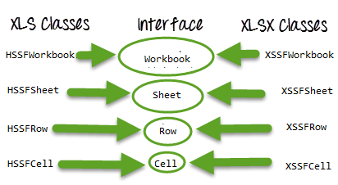
Read from & Write to Excel Sheet:
We can read and write on Excel file with the help of Java IO package and Apache POI library
Download POI jars

Slide 45
POI classes & interfaces
Workbook: XSSFWorkbook and HSSFWorkbook classes implement this interface.
XSSFWorkbook: Is a class representation of XLSX file.
HSSFWorkbook: Is a class representation of XLS file.
Sheet: XSSFSheet and HSSFSheet classes implement this interface.
XSSFSheet: Is a class representing a sheet in an XLSX file.
HSSFSheet: Is a class representing a sheet in an XLS file.
Row: XSSFRow and HSSFRow classes implement this interface.
XSSFRow: Is a class representing a row in the sheet of XLSX file.
HSSFRow: Is a class representing a row in the sheet of XLS file.
Cell: XSSFCell and HSSFCell classes implement this interface.
XSSFCell: Is a class representing a cell in a row of XLSX file.
HSSFCell: Is a class representing a cell in a row of XLS file.

Slide 46
Report Generation:Using ExtentReport
Extent Reports contain two major classes:
ExtentReports class
ExtentTest class
Syntax:
ExtentReports reports = new ExtentReports(“Path of directory to store the resultant HTML file”);
ExtentTest test = reports.startTest(“TestName”);

Slide 47
Report Generation:Using ExtentReport
Built-in methods:
startTest()
endTest()
Log()
Flush()
Test Status :
PASS
FAIL
SKIP
INFO

Slide 48
Report Generation: Using ExtentReport
Syntax:
test.log(LogStatus.PASS,”Test Passed”); test.log(LogStatus.FAIL,”Test Failed”); test.log(LogStatus.SKIP,”Test Skipped”); test.log(LogStatus.INFO,”Test Info”);
reports.endTest();

